Slide 1
Angle at Centre, Angle on Arc Investigation

Slide 2
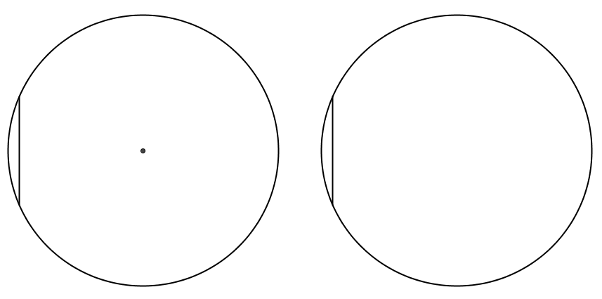
Angle at Centre, Angle on Arc Investigation
Mark a point on the circle below then join it to both ends of the chord.
SIC_16

Slide 3
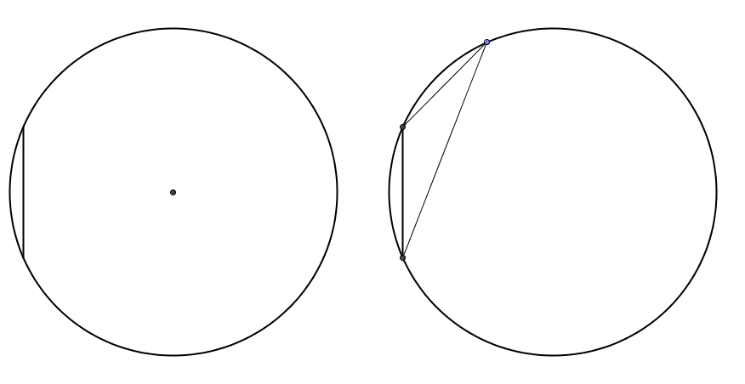
Mark another point and repeat the process.
Mark a point on the circle below then join it to both ends of the chord.

Slide 4
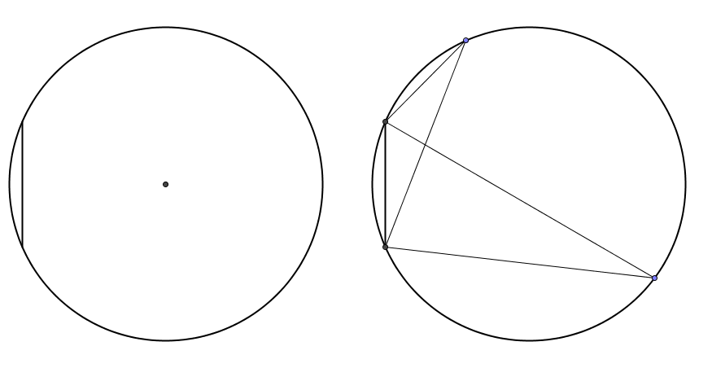
Mark another point and repeat the process.
Shade in both angles just created on the circle.

Slide 5
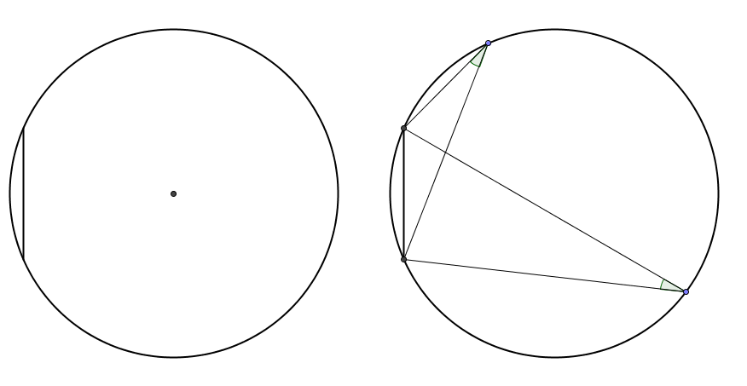
Cut out the angles and compare them to each other.
Compare them with others of the same colour card.
Shade in both angles just created on the circle.

Slide 6
Cut out the angles and compare them to each other.
Compare them with others of the same colour card.
Now join the centre of the circle to both ends of the chord.

Slide 7
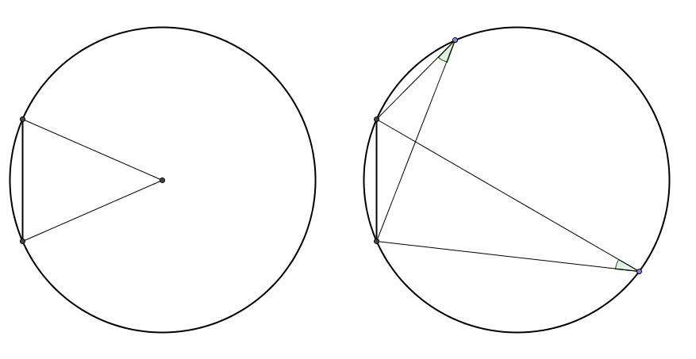
Now join the centre of the circle to both ends of the chord.
Shade in the angle then cut it out.

Slide 8
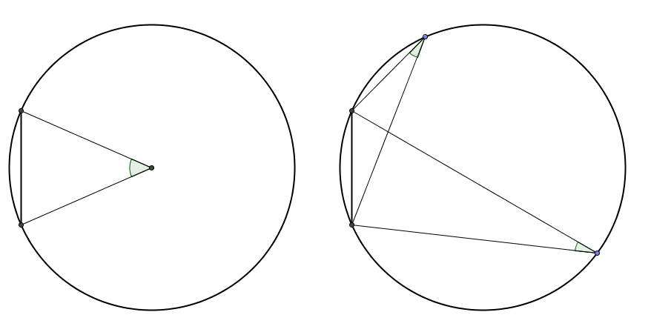
Will the two smaller angles fit in the remaining gap?
Shade in the angle then cut it out.

Slide 9
This demonstrates two circle theorems.
Angles on the same arc from a chord are equal.
Angle at the centre is twice the angle at the arc when drawn from the same chord.

Slide 10
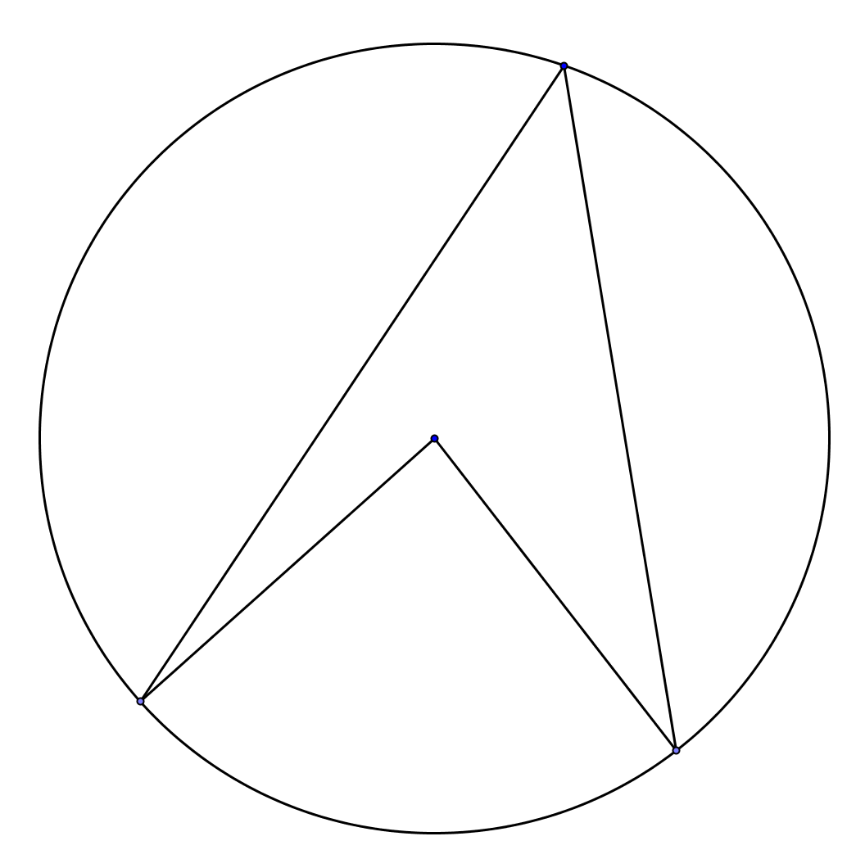

The general case
$$O$$

Slide 11
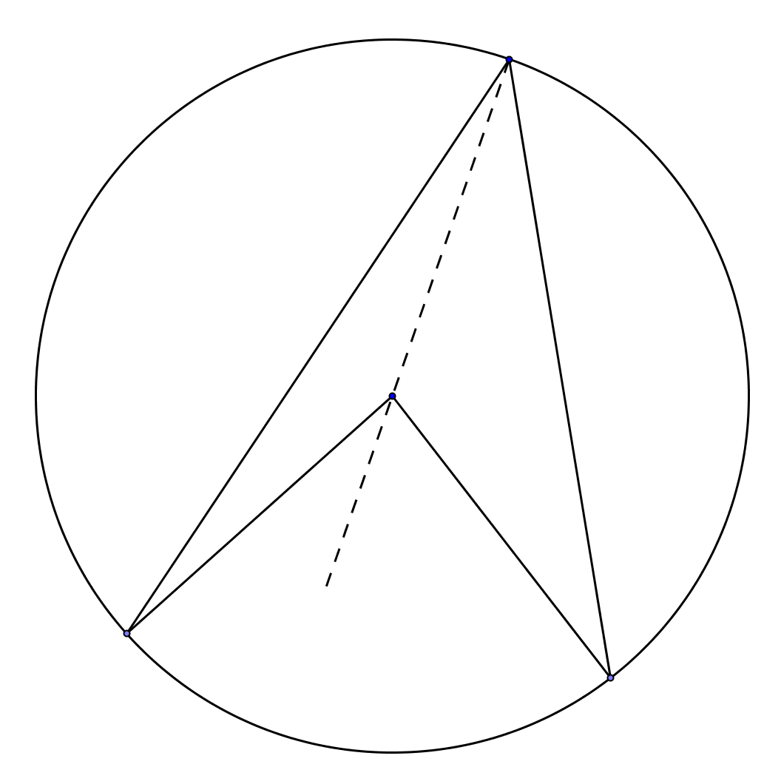
The general case
$$O$$

Slide 12
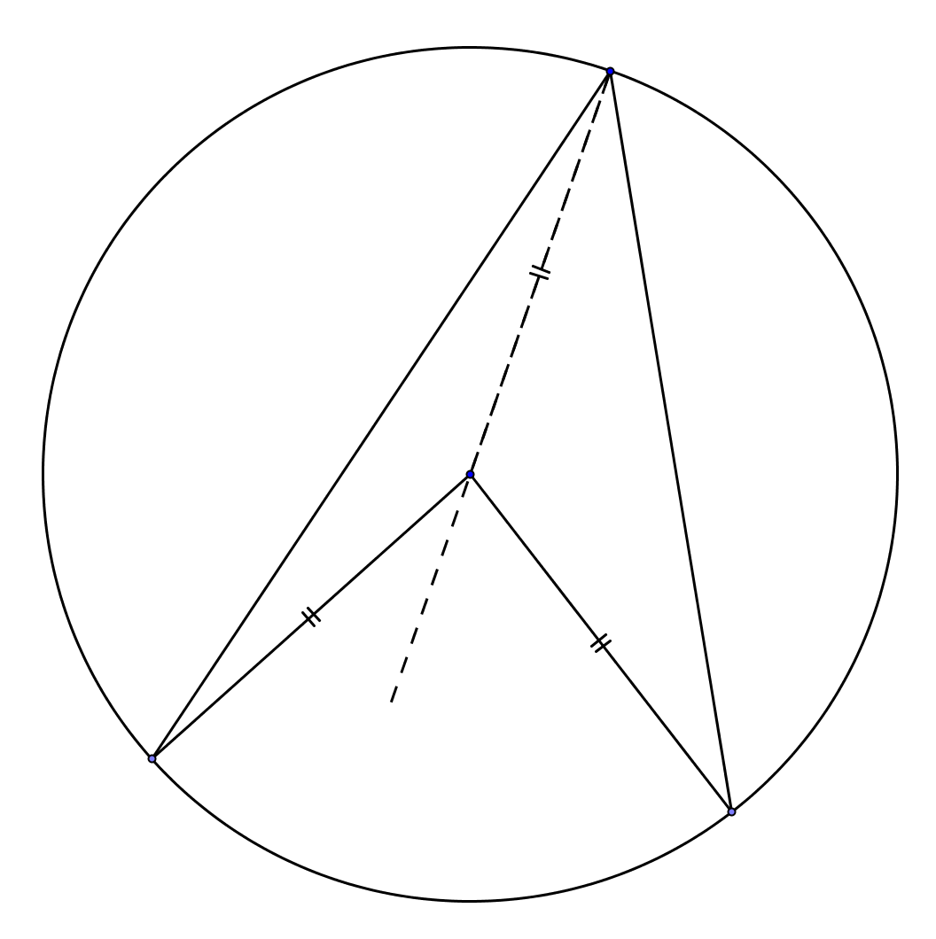
The general case
$$O$$

Slide 13






The general case
$$a$$
$$b$$
$$O$$
$$a$$
$$2a$$
$$2b$$
$$b$$

Slide 14


The general case
$$a+b$$
$$O$$
$$2\left(a+b\right)$$

Slide 16
Note to Teacher
Use different coloured card for each lettered resource - this will make it easier for the pupils to compare results.

Slide 18
RESOURCES

Slide 19
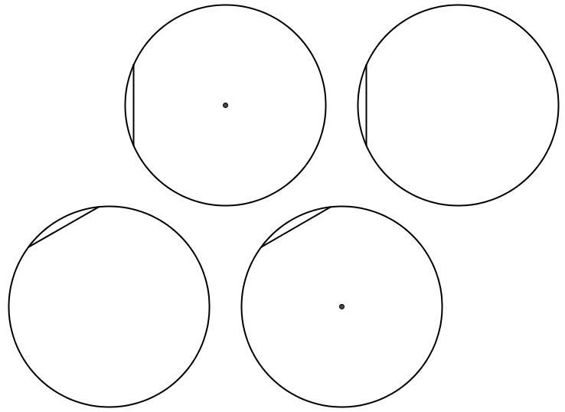
SIC_16
A
A

Slide 20
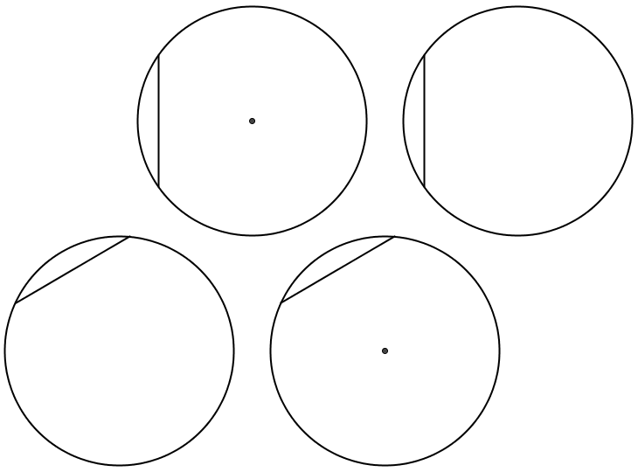
SIC_16
B
B

Slide 21
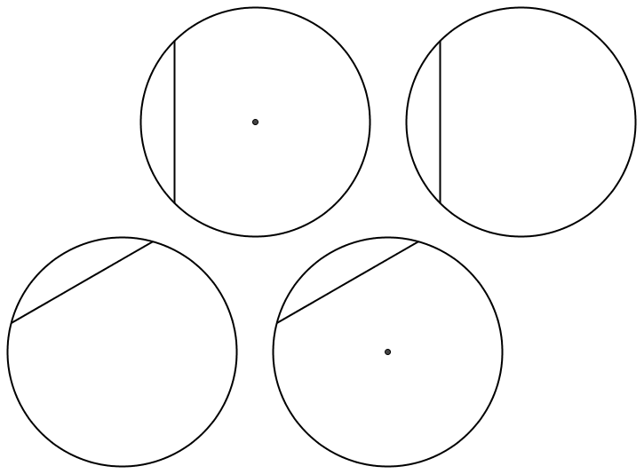
SIC_16
C
C
Notes:
45⁰ and 90⁰

Slide 22
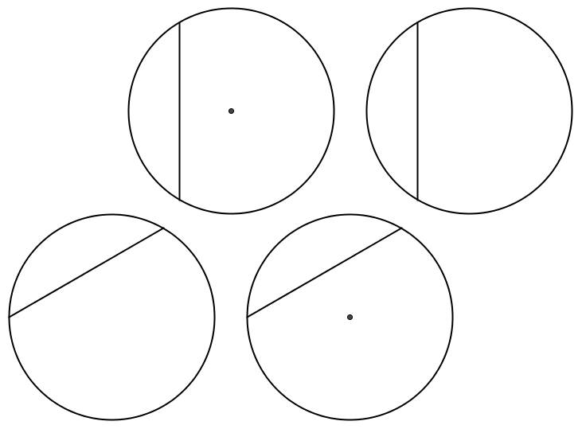
SIC_16
D
D
Notes:
60⁰ and 120⁰

